Slide 1
Arts and Crafts Online Lesson
Wk. beg. 29.06.20
ASD Summer 2 Term

Slide 2
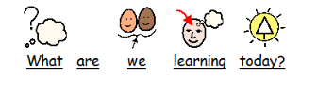

Slide 3
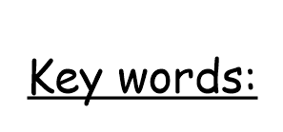
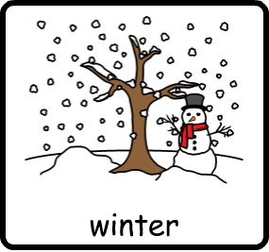

Slide 4
Arts and Craft Activity
How to use – Find the slides that best suit your child and help them to complete the activity.
Your child may need some physical or verbal support for some/all parts of the activity.

Slide 5
Today we are going to learn about the season of winter.

Slide 6
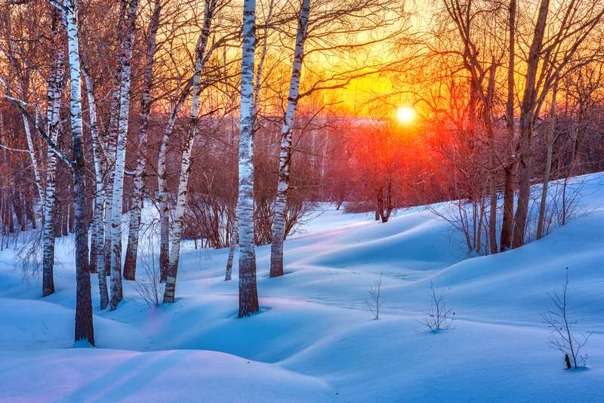
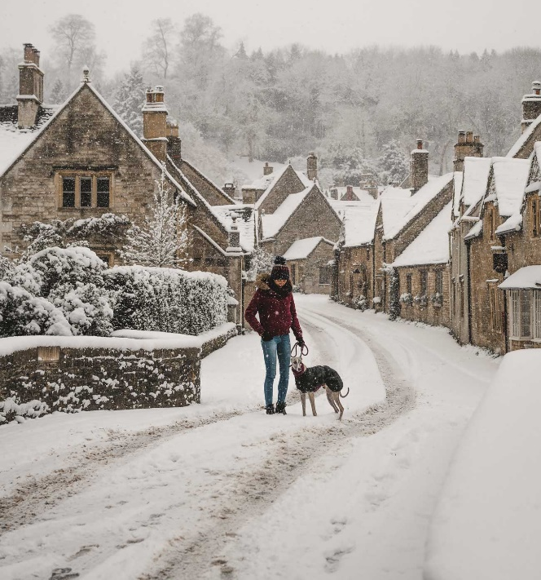
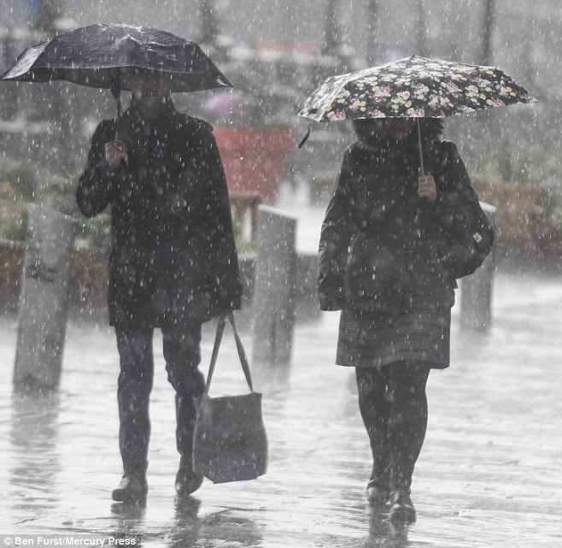

Slide 7
What do you know about the season of winter?
What do you think happens in winter?

Slide 8
Winter months are December, January and February.
Winter is the coldest season.
Snow falls in the Winter
Every snowflake has six sides.
The sun looks bigger in the Winter.
Trees stop growing in the Winter.
Plants stop growing in the Winter.
Nights are longer in the Winter.
Some animals hibernate (go to sleep) in the Winter.
Winter comes before Spring.
A blizzard is a bad snowstorm.

Slide 10
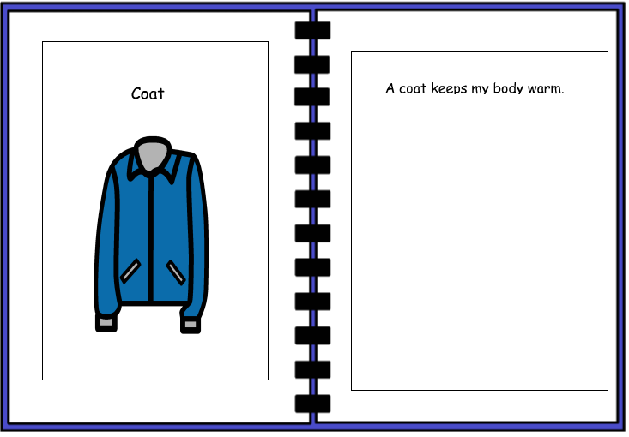
Can you verbally say the sentences?
Can you write the sentences?

Slide 11
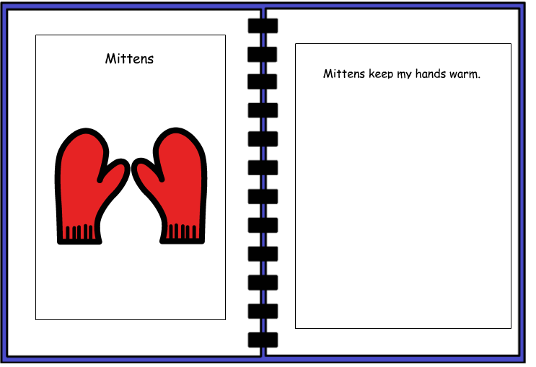

Slide 12
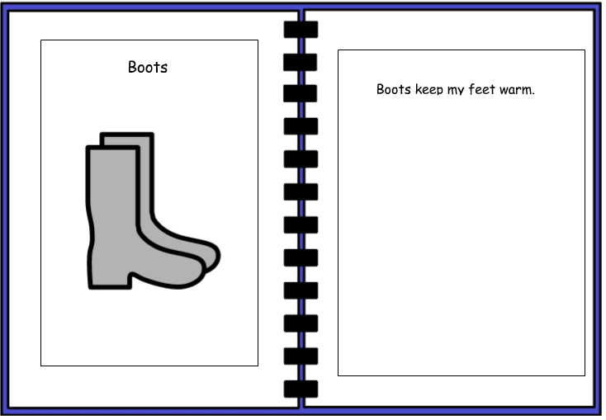

Slide 13
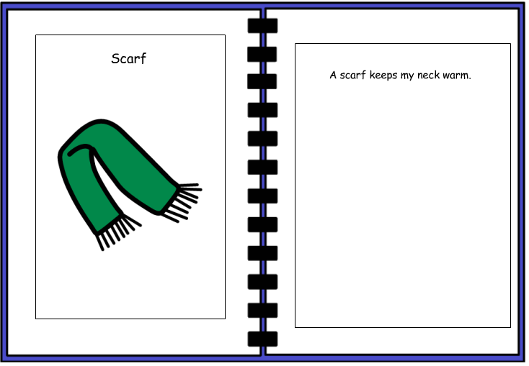

Slide 14
Can you write your own sentences about winter?
Don’t forget a capital letter and a full stop.

Slide 15
Can you make a winter picture?
What would items would you use to make your winter picture?
Why?
Can you use the symbols in this powerpoint to make your picture?
Can you use pictures from magazines to make your picture?
Can you draw items to make your picture?

Slide 16
Winter Picture

Slide 17
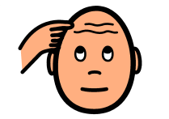
What does your winter picture look like?
What pictures or shapes did you use?
Why did you use or draw these pictures?

Slide 18
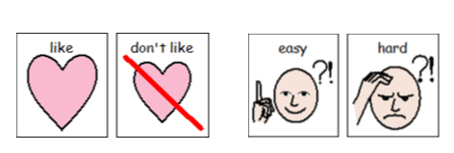

Slide 19
Please show us know your winter pictures, send us a tweet on twitter!
@NorthRidgeSch

