Slide 1


Art
Wk. beg. 22.06.20
ASD Summer 2

Slide 2
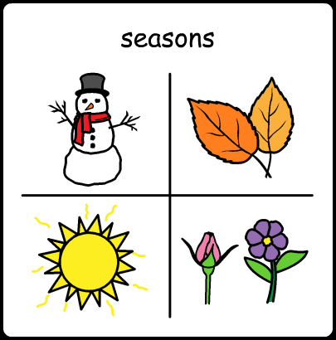
Focus: Seasons

Slide 3
Life Skills Activity
How to use – Find the slides that best suit your child and help them to complete the activity.

Slide 4
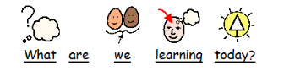

To follow instructions to create autumn arts and crafts

Slide 5

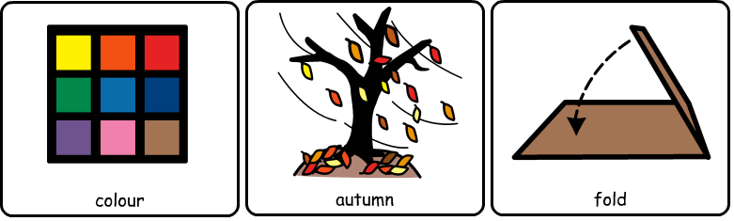

Slide 6
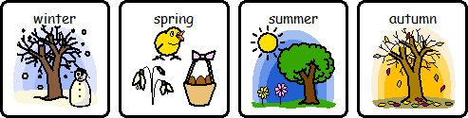
Starter
Can you name and order the seasons of the year?

Slide 7
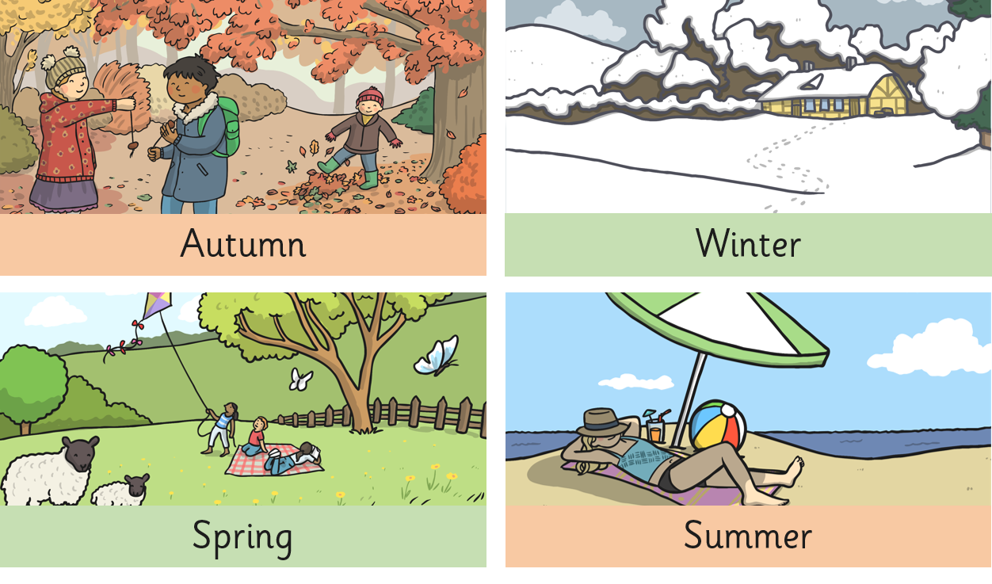
The four seasons

Slide 8
The four seasons
Autumn
Winter
September
December
October
January
November
February
Spring
Summer
March
June
April
July
May
August

Slide 9
Choose the art activity you would like to do and then follow the instructions.

Slide 10
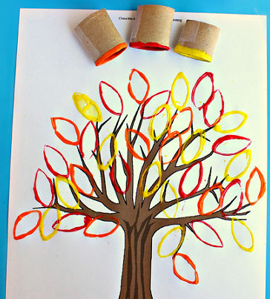
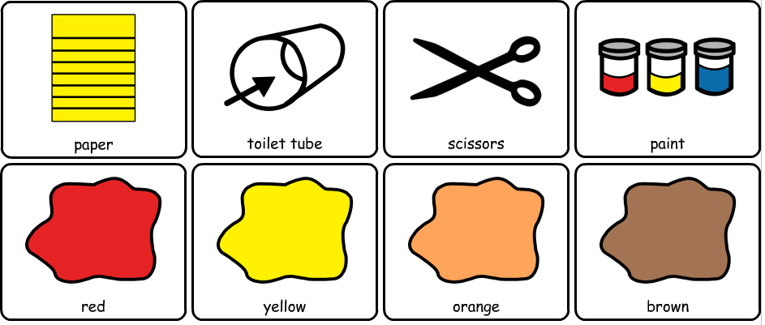
Activity 1: Toilet roll Print Autumn Tree
You will need:

Slide 11
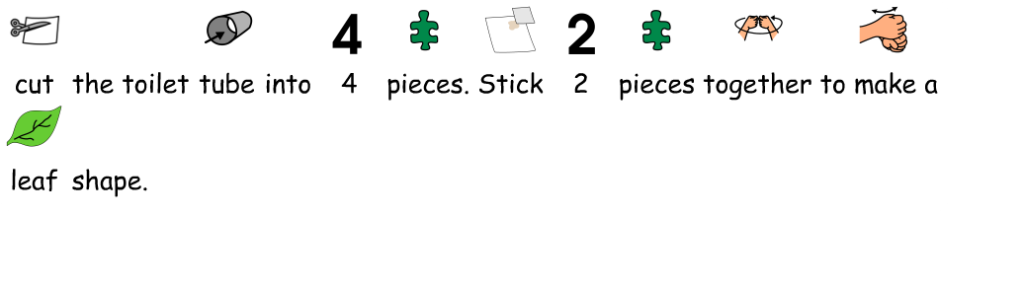
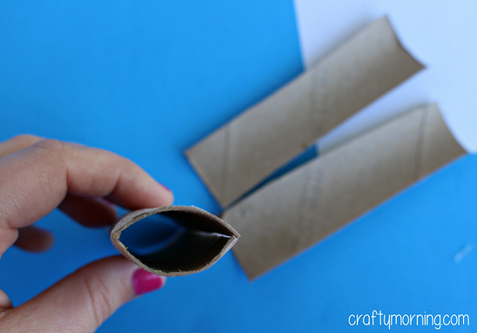
Activity 1: Toilet roll Print Autumn Tree

Slide 12
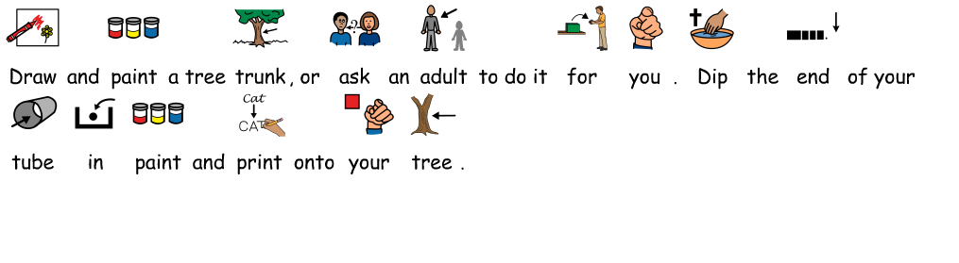
Activity 1: Toilet roll Print Autumn Tree

Slide 13
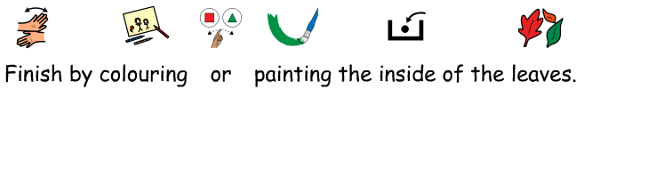
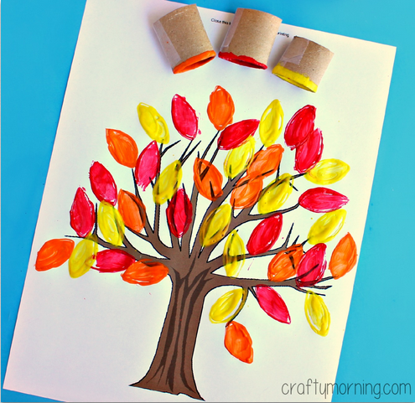
Activity 1: Toilet roll Print Autumn Tree

Slide 14
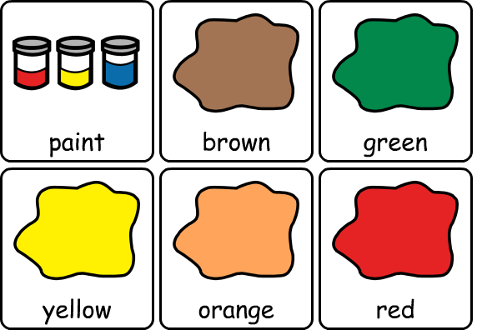

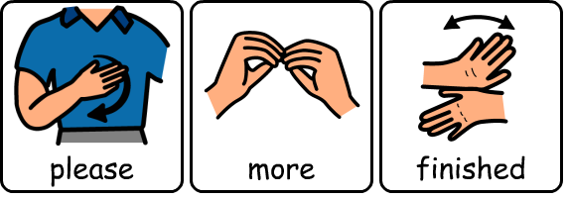
Activity 1: Toilet tube Print Autumn Tree
Use this communication board to make your colour choices

Slide 15
Activity 2: Leaf symmetry – Higher lever
Print out or trace the following slides. Can you draw the other half of the leaves and colour them in autumnal colours?

Slide 16
Activity 2: Leaf symmetry– Higher Level

Slide 17
Activity 2: Leaf symmetry– Higher Level

Slide 18
Activity 2: Leaf symmetry– Higher Level

Slide 19
Activity 2: Leaf symmetry– Higher Level

Slide 20

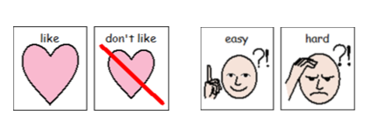

Slide 21


Please let us know how you did, send us a tweet
@NorthRidgeSch
You can also email pictures or work to: homelearning@northridge.manchester.sch.uk

