Slide 1
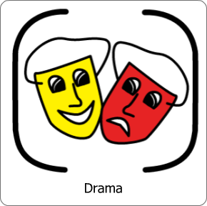
Now is…

Slide 2
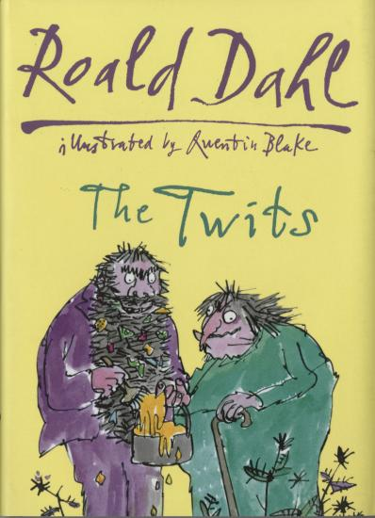
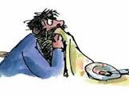
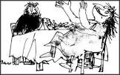
Lesson 1 recap
The Twits-
Squiggly
Spaghetti
Click here to watch the BBC’s clip

Slide 3
Learning Objectives:
Lesson 1 recap
:

Slide 4
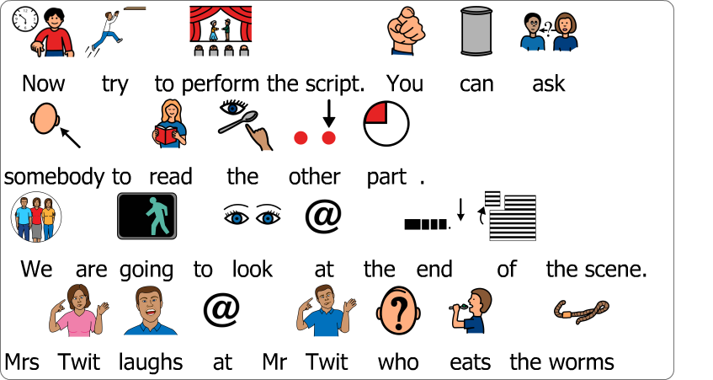
Task
Lesson 1 recap

Slide 5
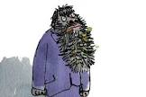
Performance script
Lesson 1 recap
Mrs Twit (Starting to shake and barely containing her laughter) So, do you want to know why your spaghetti was squishy?
Mr Twit (Wipes sauce from his beard with the tablecloth and looks suspicious) Why?!
Mrs Twit (screaming with laughter and rocking in her chair) Because it was worms you horrible old fool!
Mr Twit splutters and makes horrible sickly groaning noises ‘eww’

Slide 6
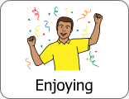
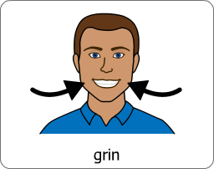
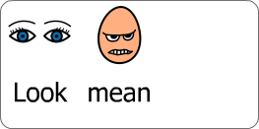
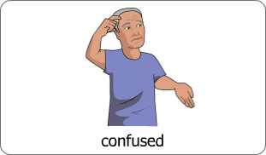
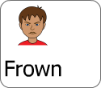
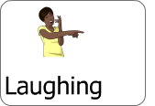
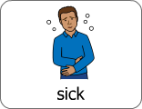
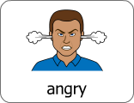
Performance script- acting suggestions
Lesson 1 recap
Mrs Twit (Starting to shake and barely containing her laughter) So, do you want to know why your spaghetti was squishy?
Mr Twit (Wipes sauce from his beard with the tablecloth and looks suspicious) Why?!
Mrs Twit (screaming with laughter and rocking in her chair) Because it was worms you horrible old fool!
Mr Twit makes horrible sickly groaning noises ‘eww’

Slide 7
Success criteria
Lesson 1 recap
Say the line or sign ‘why’
‘eww’ or groan when you find out it is worms you are eating
Pretend to spit the food out
Shake your head
Say or sign the lines of Mrs Twit
Use your face to make Mrs Twit look mean
Try to change your voice to sound mean
Start to smile when Mr Twit tries his spaghetti
Start to laugh after you say ‘it was worms you horrible old fool
Use your voice to sound like you are planning something bad.
Change your voice, say ‘it was worms you horrible old fool’ in a louder voice
Use your body to ‘hunch’ like Mrs Twit
Laugh uncontrollably when Mr Twit finds out he is eating worms. Build this up by giggling before
Try to learn the rest of the script
Stay in character the whole time

Slide 8
Now is…
Lesson 2

Slide 9
Learning Objectives: Performing Freeze Frames
Lesson 2

Slide 10
Please watch the video to find out what freeze frames are
Lesson 2

Slide 11
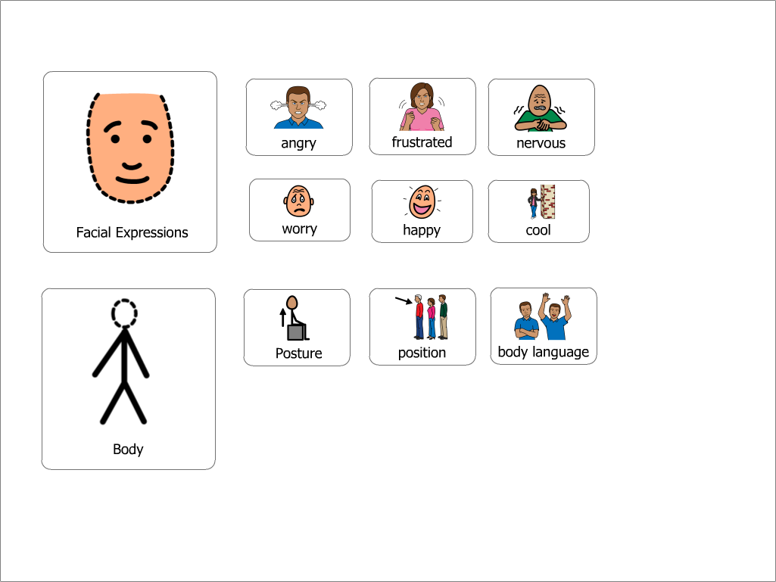
Lesson 2
What a freeze frame is
A Freeze frame is a technique in which actors freeze at a particular point to enhance a scene or show an important moment in production. Image you are in a photograph
What makes a good freeze frame
You should make it clear what is happening
Show us what your character is thinking and feeling or saying through your face and body
Stay still
Stay in character (do not laugh0
Make it interesting, do different things

Slide 12
Today’s challenge
Lesson 2
Perform the scene squiggly spaghetti through a selection of still images
Tip
You can choose to be Mr or Mrs Twit or both. Ask someone to join in and help you.

Slide 13
Lesson 2
Challenge by group
Perform all 3 images making sure there is a clear difference in each scene
Make sure the image tells the story
Make sure you keep still
Watch the BBC clip again
Pick 3 key moments and make a freeze frame of these
Make sure the freeze frame is interesting, different and tell the story
Choose from one of the images to create a Freeze frame of the scene ‘squiggly spaghetti’
Try to keep still in position for 5 minutes
Red group please skip the next slide!

Slide 14
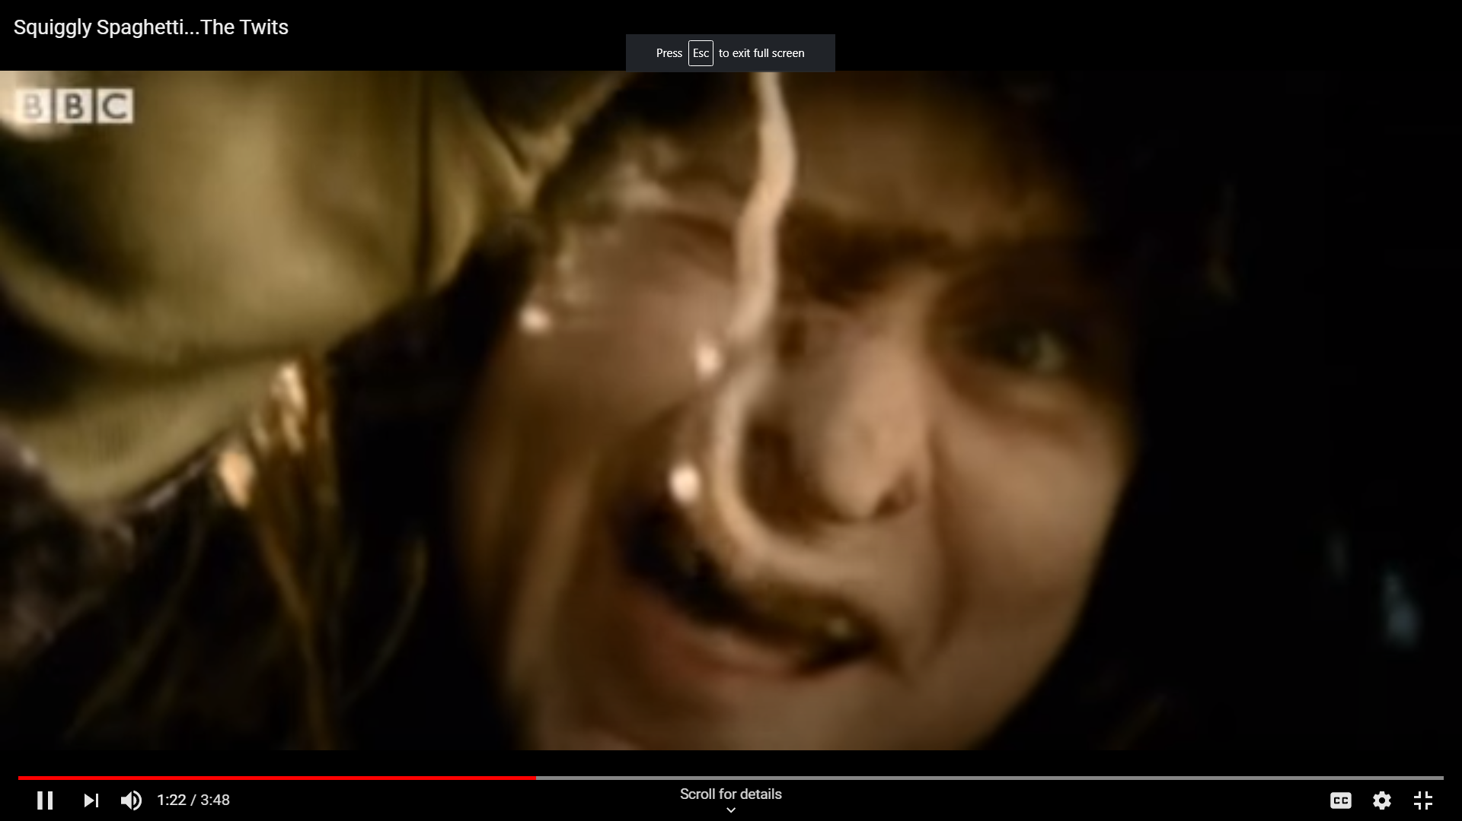
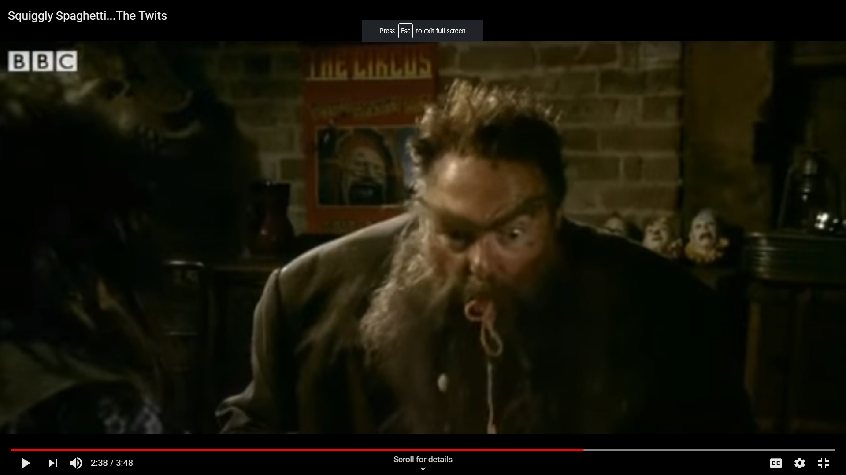
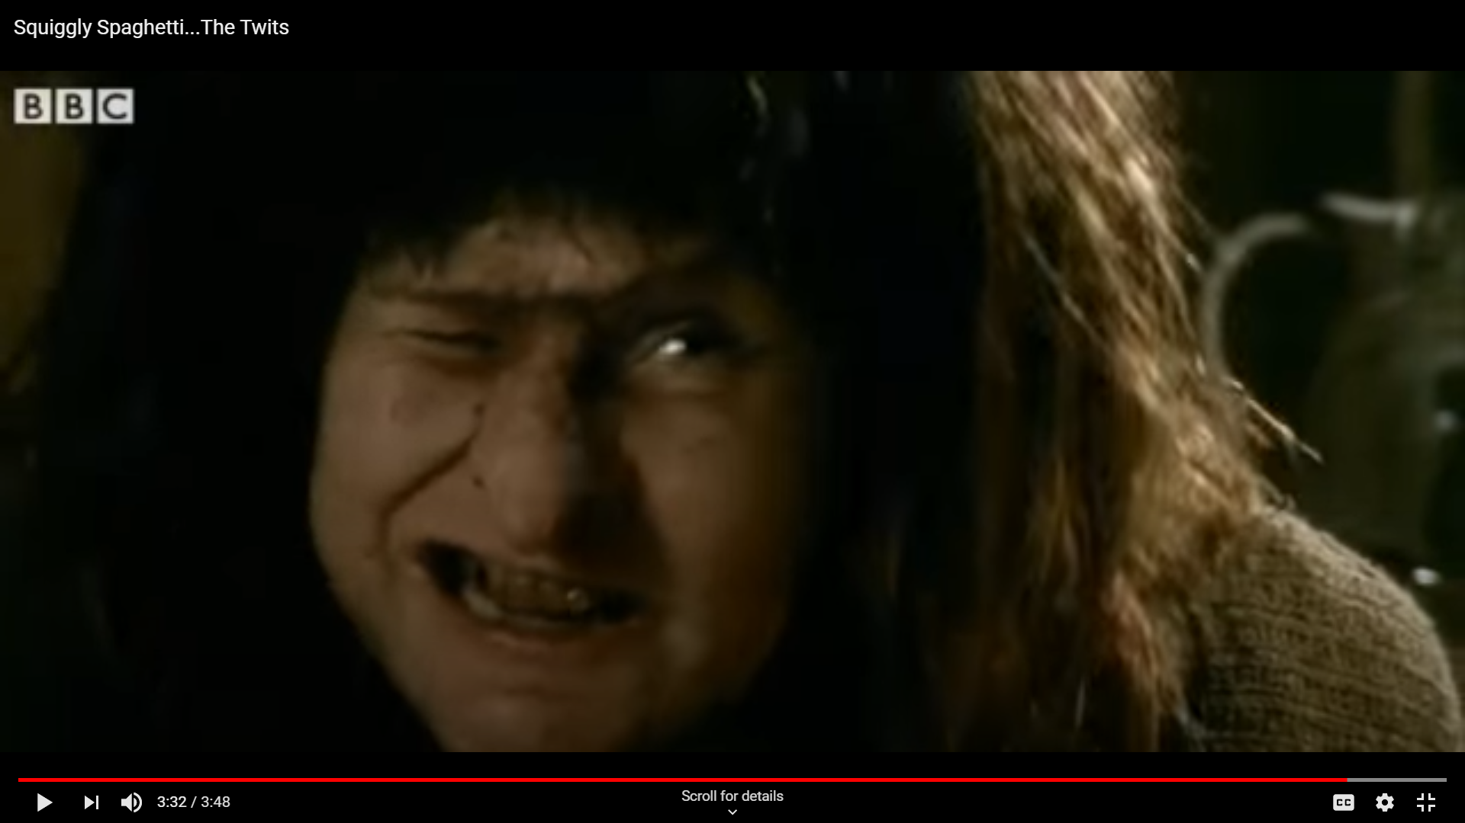
Key moments
Lesson 2
Perform all 3 images making sure there is a clear difference in each scene
Make sure the image tells the story
Make sure you keep still
Choose from one of the images to create a Freeze frame of the scene ‘squiggly spaghetti’
Try to keep still in position for 5 minutes
1
2
3
Mrs Twit laughs as she tells Mr Twit what he has ate. Mr Twit spits out the worms
Mrs Twit collects worms
Mr Twit is hungry at the table
Mrs watches as Mr Twit eats the wormy spaghetti

Slide 15
The Twits (Play script)
List of Characters (3):
Narrator
Mr Twit
Mrs Twit
Scene Seven – The Wormy Spaghetti
(Lunchtime at the Twit’s dirty, grubby dinner table)
Narrator:
To get her revenge for the frog trick, Mrs Twit has dug up some wriggly garden worms and put them in Mr Twit’s lunchtime spaghetti.
Oh yes - She was going to enjoy this lunch.. Cheery music)
Mr Twit: (Yelling with shock) Hey, my spaghetti’s moving!
Mrs Twit (Smiling mischievously) It’s a new kind dear– It’s called Squiggly Spaghetti.
It’s delicious. Go on - eat it up while its nice and hot (takes a forkful of her own spaghetti)
Mr Twit: (Loudly talking with his mouth full) It’s not as good as the ordinary kind – It’s much too squishy. (a worm falls from his fork into his filthy beard)
Mrs Twit (Smiling cheerfully) I find it very tasty (takes another mouthful happily)

Slide 16
Mr Twit (Barking grumpily) No! No! I find it rather bitter – very bitter! Buy the other kind next time.
Narrator: It was giving Mrs twit such enormous pleasure watching her horrible husband eat worms she felt like she might burst on the spot!
Mrs Twit (Starting to shake and barely containing her laughter) So, do you want to know why your spaghetti was squishy?
Mr Twit (Wipes sauce from his beard with the tablecloth and looks suspicious) Why?!
Mrs Twit (screaming with laughter and rocking in her chair) Because it was worms you horrible old fool! (laughs so much falls off chair while Mr Twit splutters and makes horrible sickly groaning noises)
Narrator:
So…sometimes revenge is a dish best served warm – with worms!!

