Slide 1
Now is…

Slide 2
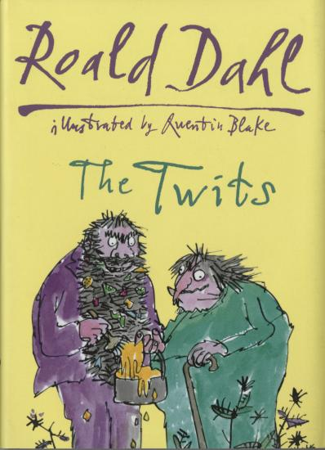
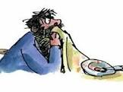
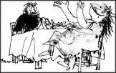
The Twits-
Squiggly
Spaghetti
Click here to watch the BBC’s clip

Slide 3
Learning Objectives:
:

Slide 4
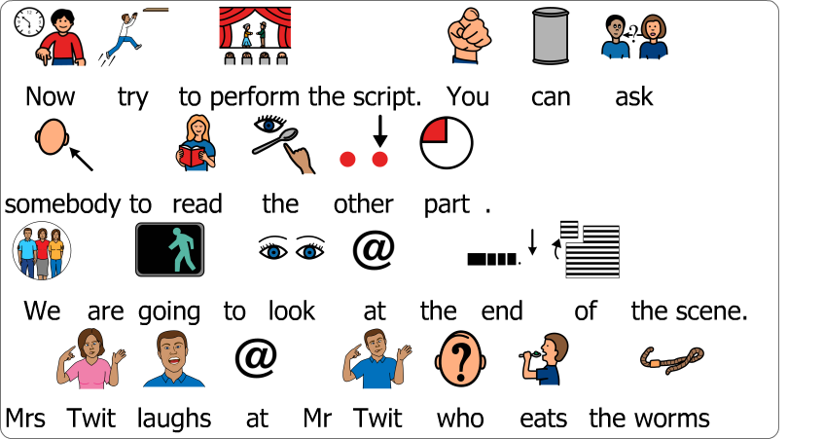
Task

Slide 5
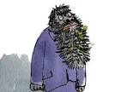
Performance script
Mrs Twit (Starting to shake and barely containing her laughter) So, do you want to know why your spaghetti was squishy?
Mr Twit (Wipes sauce from his beard with the tablecloth and looks suspicious) Why?!
Mrs Twit (screaming with laughter and rocking in her chair) Because it was worms you horrible old fool!
Mr Twit splutters and makes horrible sickly groaning noises ‘eww’

Slide 6
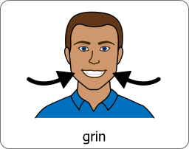
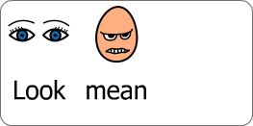
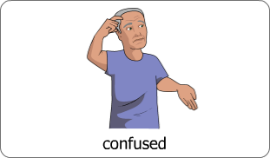
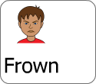
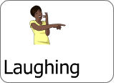
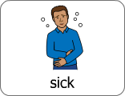
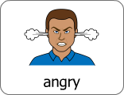
Performance script- acting suggestions
Mrs Twit (Starting to shake and barely containing her laughter) So, do you want to know why your spaghetti was squishy?
Mr Twit (Wipes sauce from his beard with the tablecloth and looks suspicious) Why?!
Mrs Twit (screaming with laughter and rocking in her chair) Because it was worms you horrible old fool!
Mr Twit makes horrible sickly groaning noises ‘eww’

Slide 7
Success criteria
Say the line or sign ‘why’
‘eww’ or groan when you find out it is worms you are eating
Pretend to spit the food out
Shake your head
Say or sign the lines of Mrs Twit
Use your face to make Mrs Twit look mean
Try to change your voice to sound mean
Start to smile when Mr Twit tries his spaghetti
Start to laugh after you say ‘it was worms you horrible old fool
Use your voice to sound like you are planning something bad.
Change your voice, say ‘it was worms you horrible old fool’ in a louder voice
Use your body to ‘hunch’ like Mrs Twit
Laugh uncontrollably when Mr Twit finds out he is eating worms. Build this up by giggling before
Try to learn the rest of the script
Stay in character the whole time

Slide 8
The Twits (Play script)
List of Characters (3):
Narrator
Mr Twit
Mrs Twit
Scene Seven – The Wormy Spaghetti
(Lunchtime at the Twit’s dirty, grubby dinner table)
Narrator:
To get her revenge for the frog trick, Mrs Twit has dug up some wriggly garden worms and put them in Mr Twit’s lunchtime spaghetti.
Oh yes - She was going to enjoy this lunch.. Cheery music)
Mr Twit: (Yelling with shock) Hey, my spaghetti’s moving!
Mrs Twit (Smiling mischievously) It’s a new kind dear– It’s called Squiggly Spaghetti.
It’s delicious. Go on - eat it up while its nice and hot (takes a forkful of her own spaghetti)
Mr Twit: (Loudly talking with his mouth full) It’s not as good as the ordinary kind – It’s much too squishy. (a worm falls from his fork into his filthy beard)
Mrs Twit (Smiling cheerfully) I find it very tasty (takes another mouthful happily)

Slide 9
Mr Twit (Barking grumpily) No! No! I find it rather bitter – very bitter! Buy the other kind next time.
Narrator: It was giving Mrs twit such enormous pleasure watching her horrible husband eat worms she felt like she might burst on the spot!
Mrs Twit (Starting to shake and barely containing her laughter) So, do you want to know why your spaghetti was squishy?
Mr Twit (Wipes sauce from his beard with the tablecloth and looks suspicious) Why?!
Mrs Twit (screaming with laughter and rocking in her chair) Because it was worms you horrible old fool! (laughs so much falls off chair while Mr Twit splutters and makes horrible sickly groaning noises)
Narrator:
So…sometimes revenge is a dish best served warm – with worms!!

