Slide 1
English and Reading Online Lesson
Wk. beg. 22.04.20
ASD Summer 2 Term

Slide 2
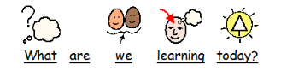

Slide 4
Starter:
Interactive games
Yellow Group- https://www.phonicsplay.co.uk/SoundStimuli.html
Red Group- https://www.phonicsplay.co.uk/BuriedTreasure2.html
Blue Group- https://www.ictgames.com/mobilePage/forestPhonics/index.html

Slide 5
Literacy Activity
How to use – Find the slides that best suit your child and help them to complete the activity.
The slides will indicate which learning group the activity is created for. The adult in contact with you from school will tell you which learning group your child is in.

Slide 6
Today we are going to read a in interactive story called The Girl Who Went to Space.
I hope you enjoy it!
Get ready to do the activities after the story.

Slide 7
https://www.twinkl.co.uk/go/resource/t2-s-1183-the-girl-who-went-to-space-animation

Slide 8
Yellow Group
Can you match the keywords to the pictures from the story?

Slide 9
Tammy
Earth
Yellow Group
Planets
Rocket
Astronaut
Space

Slide 10
Red Group
Can you verbally retell the story using the keywords?
Can you use the keywords in the correct order?

Slide 11
Red Group

Slide 12
Can you verbally retell the story using the keywords?
Can you use the keywords in the correct order? (Look at the slides before this one to help you)
Can you add another part of the story?
Blue Group

Slide 13
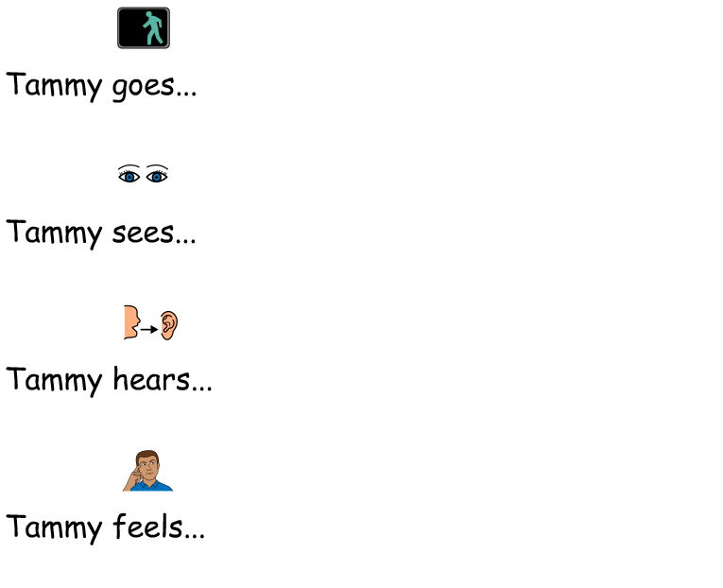
Blue Group

Slide 14
Did you like the story? YES NO
What did you like about the story?
Can you create a new planet?
You could use chalks, paint and colouring pencils.
Can you describe your planet?

Slide 15
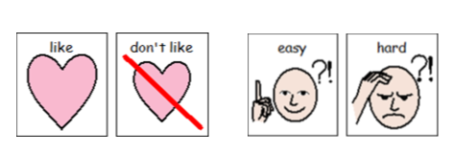

Slide 16
Please show us know your work, send us a tweet on twitter!
@NorthRidgeSch

