Slide 4
Discuss what key features can you see in the recipe?
On the next side use the symbols to help you label the key pieces of information.

Slide 5
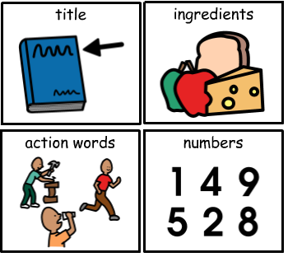

Slide 7
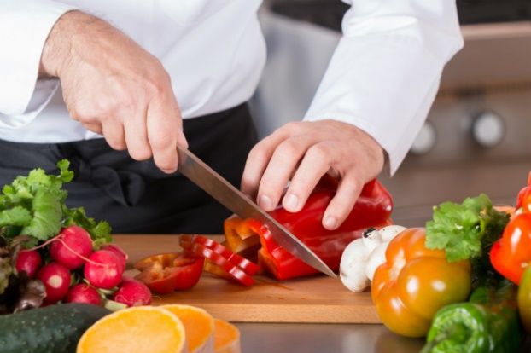
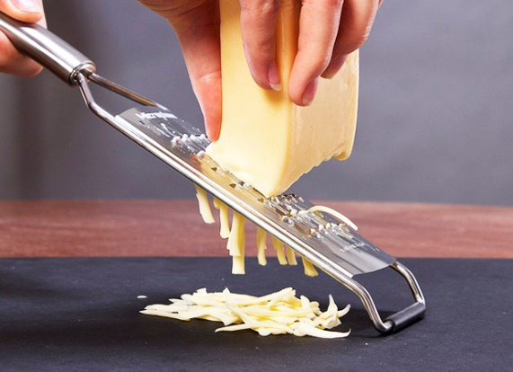
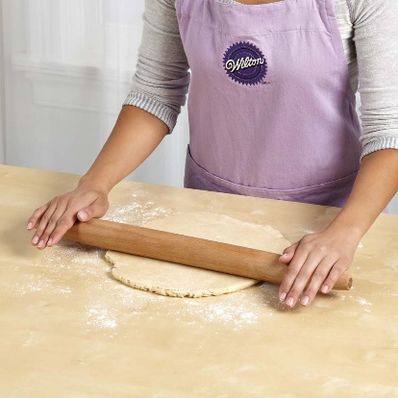
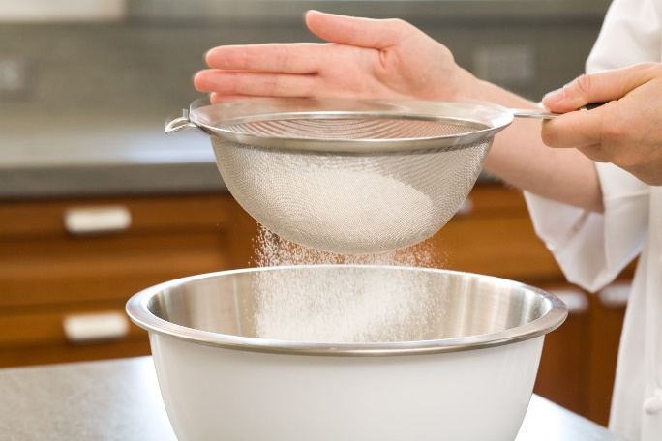
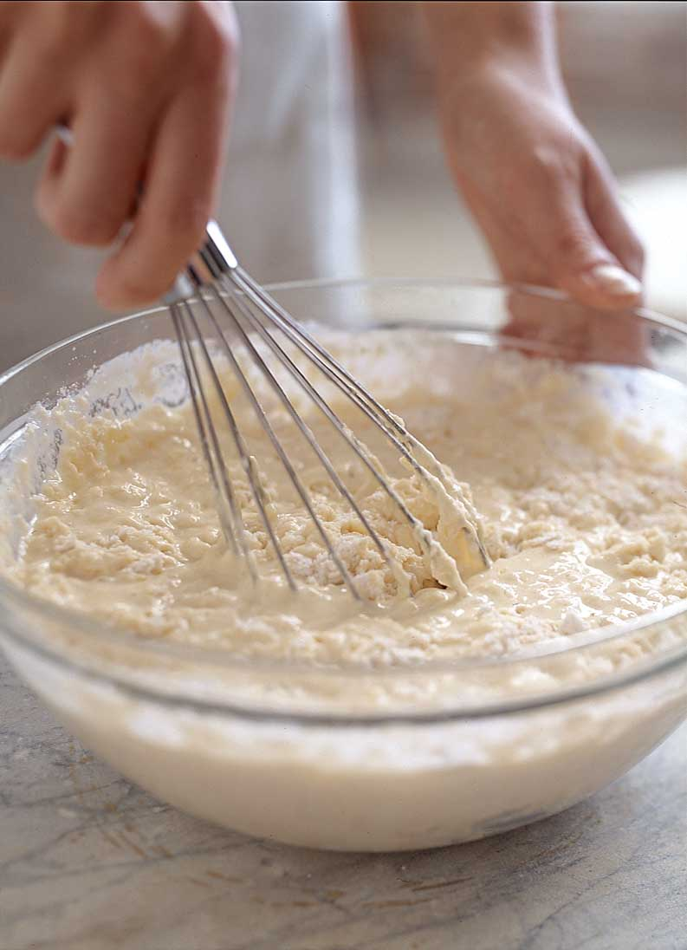
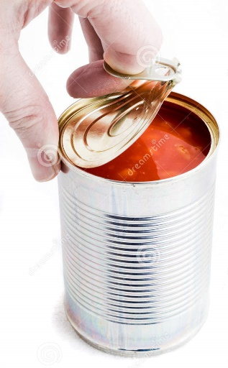
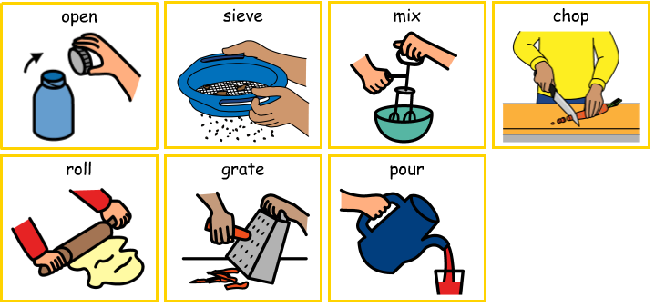
The instructions in the recipe tell us what to do. Use the symbols to identify what action you can see happening in each image.

Slide 8
Lets see if you were right

Slide 9
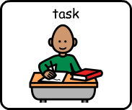
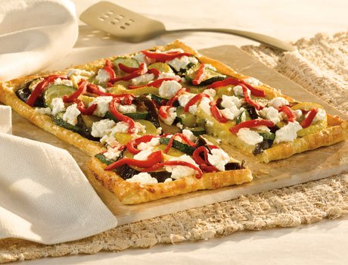
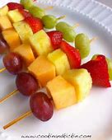
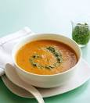
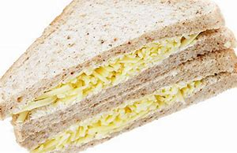
Choose one of the recipes below. Can you read that recipe and make the item. You may have to write a shopping list to buy the ingredients from the supermarket. Post a picture of your creation on the school twitter page!!
Vegetable puff pastry
Fruit Skewers
Vegetable Soup
Cheese sandwich

Slide 14
