Slide 4
So you can…

Slide 5
https://www.youtube.com/watch?v=-JldSBUQB34

Slide 6
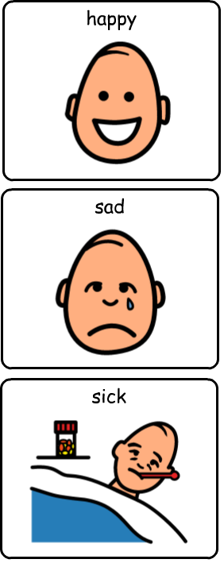
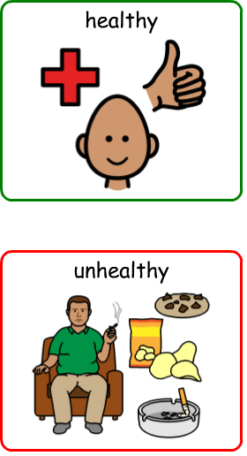

Slide 7
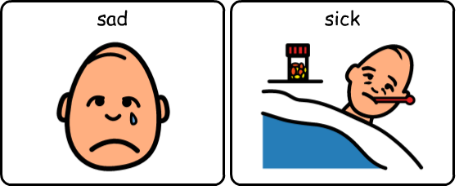

Slide 8
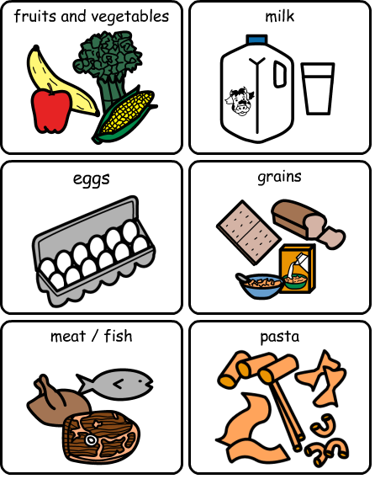
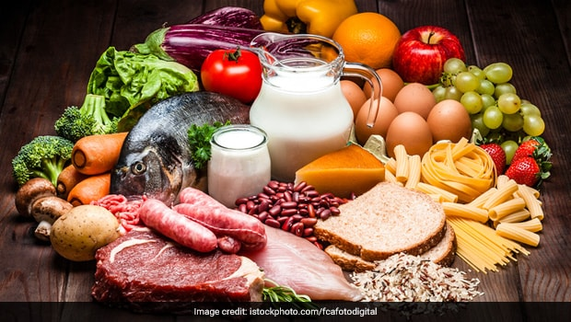

Slide 9
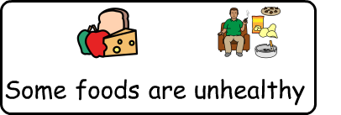
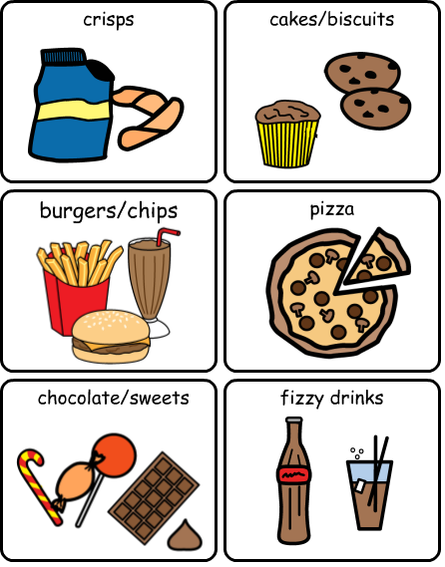
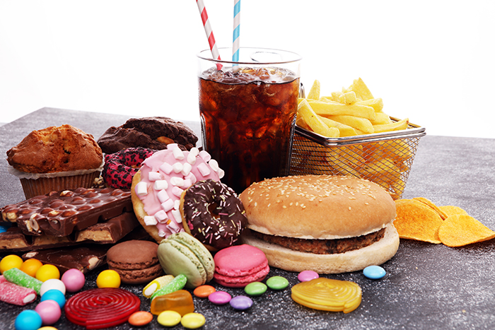

Slide 10
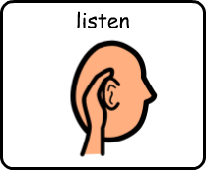
Listen to each clue. What food do you think is being described?
Select your answer from the symbols.
Is that food healthy or unhealthy?

Slide 11
Listen to each clue. What food do you think is being described?
Select your answer from the symbols.
Is that food healthy or unhealthy?

Slide 12
Listen to each clue. What food do you think is being described?
Select your answer from the symbols.
Is that food healthy or unhealthy?

Slide 13
Listen to each clue. What food do you think is being described?
Select your answer from the symbols.
Is that food healthy or unhealthy?

Slide 14
Listen to each clue. What food do you think is being described?
Select your answer from the symbols.
Is that food healthy or unhealthy?

Slide 15
Listen to each clue. What food do you think is being described?
Select your answer from the symbols.
Is that food healthy or unhealthy?

Slide 16
Click on your coloured group to access your work. If you are unsure which group you are in ask your teacher.

Slide 17
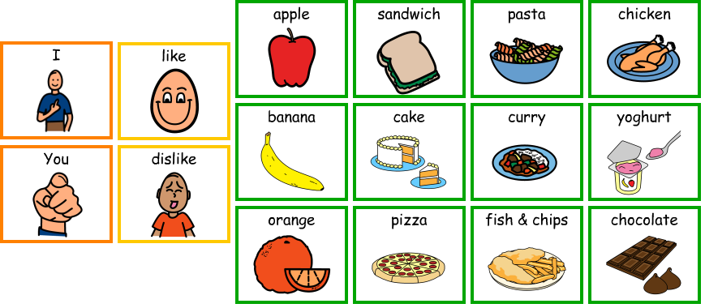
Point to the symbols on the screen to write your food fact file.

Slide 18
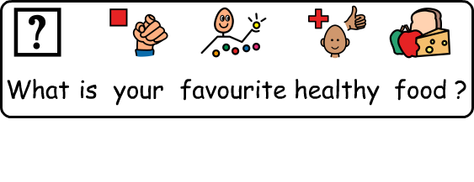
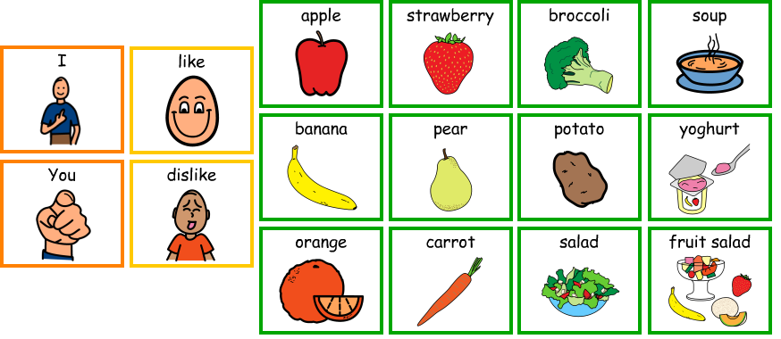
Point to the symbols on the screen to write your food fact file.

Slide 19
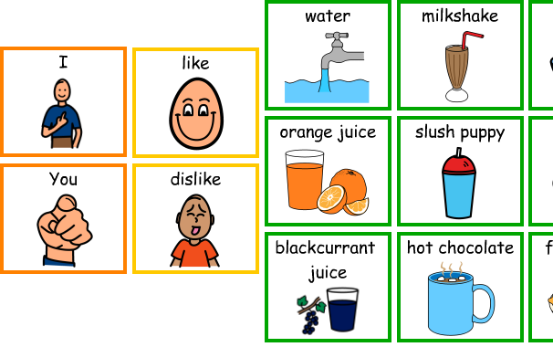
Point to the symbols on the screen to write your food fact file.

Slide 20
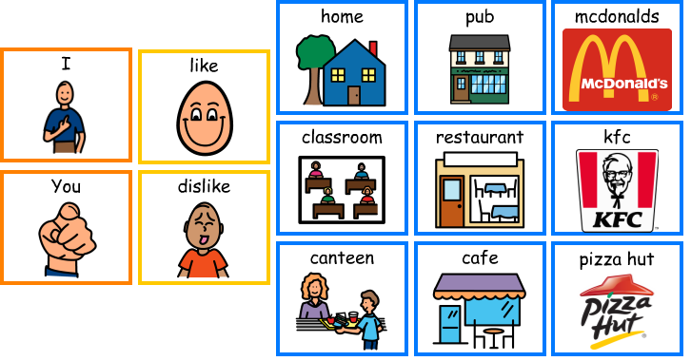
Point to the symbols on the screen to write your food fact file.

Slide 21
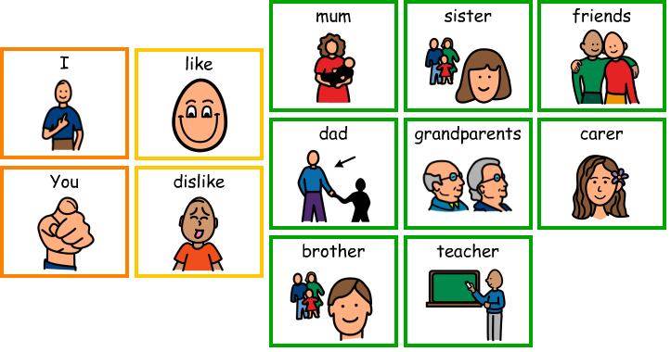
Point to the symbols on the screen to write your food fact file.

Slide 22
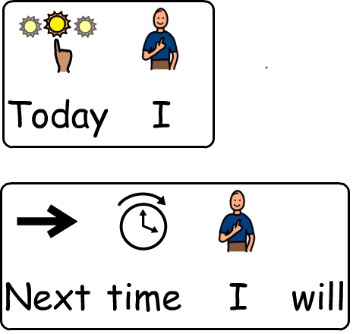
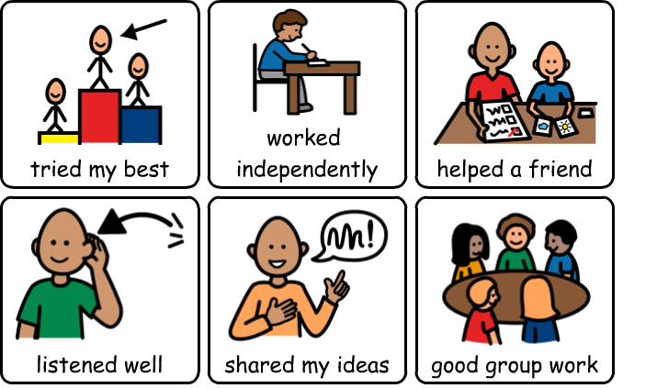

Slide 23
You will need a piece of paper and a pencil. Write each question down – leave a gap between each one to write your answers. Use the symbols on the following page to help you write your sentences.
1)
4)
2)
5)
3)

Slide 24
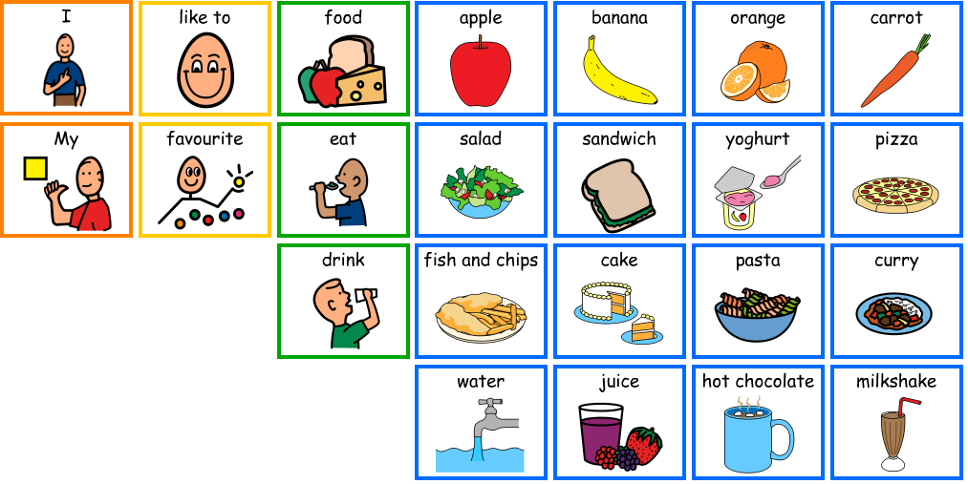
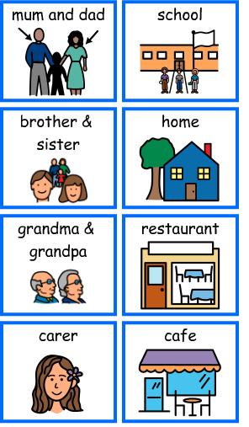
Words to include:
at with to in

Slide 26
Write each question down on a piece of paper, leave a gap underneath each one to write your answers. Write your answers in full sentences.
1) What are your favourite foods?
2) What is your favourite healthy food?
3) What are your favourite drinks?
4) Where do you like to eat?
5) Who do you like to eat with?

