Slide 1
KS4 Life Skills
Staying safe in the hot weather

Slide 2
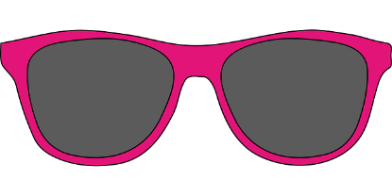
How can I keep safe during the warm weather?
It can be so much fun to be outside in the sunshine, but without taking care of ourselves we may become too hot, burn our skin and become dehydrated (not enough water).
We need too; wear appropriate clothing, which means cool breathable fabrics and not too many layers, drink fluids and wear sun cream.
Click onto the next slide to complete the drag and drop activity.

Slide 3
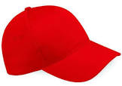
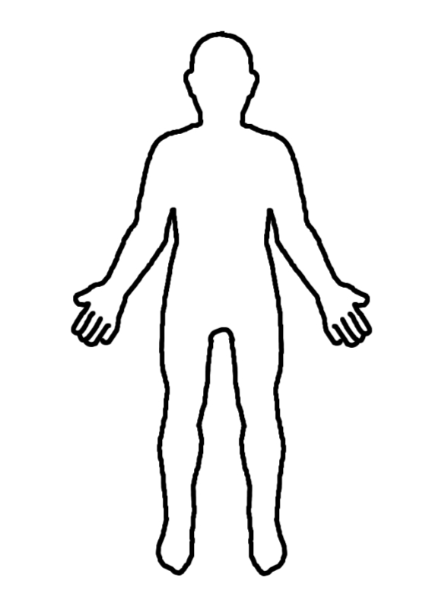
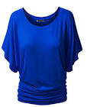
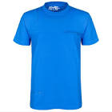
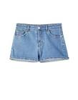
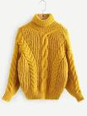
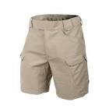
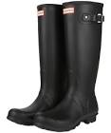
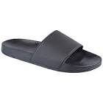
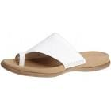
Drag and drop the pictures of; appropriate clothing on a warm day, you should look for cool fabrics.

Slide 4
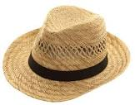
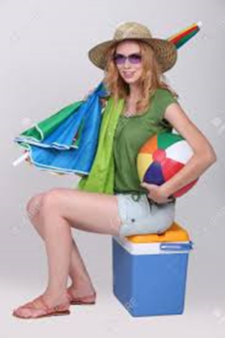
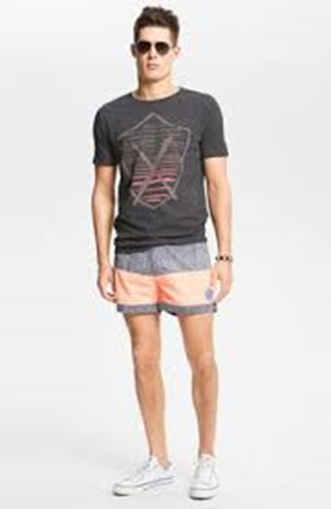
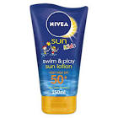
Fill the blanks in the sentences below, you can write/type the answer or drag the picture.
1. To stay safe in the hot weather it is important I wear __________ clothing.
2. To stay hydrated in the hot weather it is important I drink lots of ______________.
3. To take care of my skin and make sure I don’t burn I need to sit in the ___________ and wear _________.
4. To keep my head cool I can wear a ___________.
cool hat shade water sun cream

