Slide 1
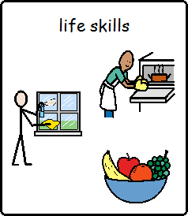
Life skills
Independent Living

Slide 4
Keeping healthy:
To keep healthy we need to:
Eat and drink healthy food.
Keep active
Personal hygiene

Slide 5
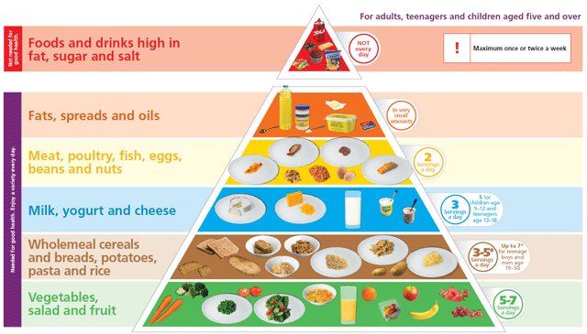

Slide 6
What activities could you do to keep healthy?
Name three activities you have been doing at home to keep healthy:

Slide 7
Exercise ideas:
https://www.youtube.com/watch?v=X655B4ISakg
https://www.youtube.com/watch?v=L_A_HjHZxfI

Slide 8
What is personal hygiene?
Personal hygiene is how you care for your body. This practice includes bathing, washing your hands, brushing your teeth, and more. Every day, you come into contact with millions of outside germs and viruses. They can linger on your body, and in some cases, they may make you sick.

Slide 9
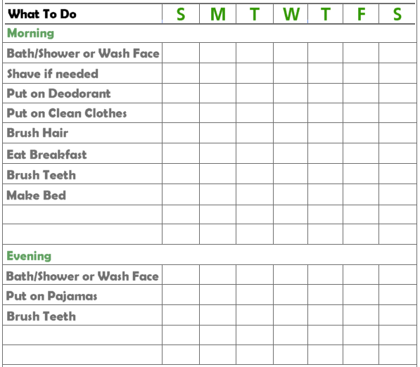
Personal hygiene checklist:

Slide 10
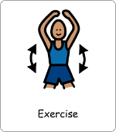
Make a food and exercise diary:

