Slide 1
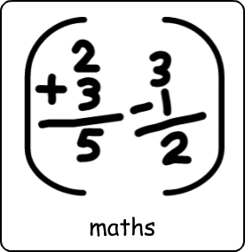

Slide 2
Learning objective

Slide 3
Key words

Slide 4
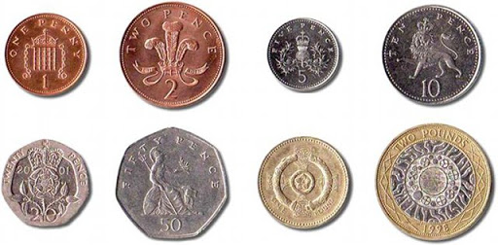

Slide 5
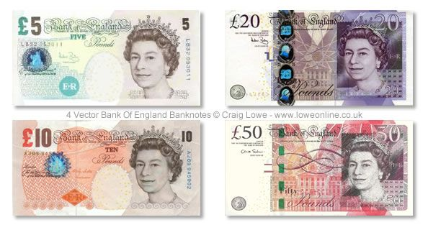

Slide 6
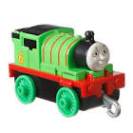
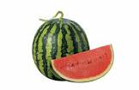
= 10p
+
+
4p
2p
4p
Add the prices together
Add the prices together
￼ + ￼ =
5p 7p
￼ + ￼ =
5p 7p
￼ + ￼ =
9p 6p
￼ +￼ =
4p 8p

Slide 7
= 16p
+
+
6p
5p
5p
Add the prices together
Add the prices together
￼ + ￼ =
5p 7p
￼ + ￼ =
5p 7p
￼ + ￼ =
9p 6p
￼ +￼ =
4p 8p

Slide 8
+
+
= 24p
4p
12p
8p

Slide 9
+
+
= 34p
16p
10p

Slide 10
+
= £9
+

Slide 11
+
+
= £12
£5
£4
£3

Slide 12
Which note can you use to pay for the items?
= £12

Slide 13
https://central.espresso.co.uk/espresso/primary_uk/subject/module/activity/item347213/grade1/module849256/index.html
https://central.espresso.co.uk/espresso/primary_uk/subject/module/activity/item258734/grade1/module849256/index.html
https://central.espresso.co.uk/espresso/primary_uk/subject/module/activity/item258737/grade1/module849256/index.html
https://central.espresso.co.uk/espresso/primary_uk/subject/module/activity/item854393/grade1/module849256/index.html

Slide 14
This PowerPoint is to help you with your maths worksheets in your work pack. Use the number lines and numicon to help you. Enjoy and stay safe!

