Slide 1
Phonics
24.06.20
Each week will we focus on a different phonic.
You will need to go through the PowerPoint and then download the worksheet of you rclour groaup

Slide 2
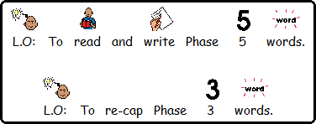
Learning Objectives: Phonics and Spag
Lesson 1
L.O: To write BOYS sentences
But Or Yet So

Slide 3
Lesson 1
Challenge by group
Write and spell and sound out ar words
Go to slide 11
Download the Blue worksheet and complete
Complete all other slides with help
Write and spell and sound out ‘ai’ words
Go to slide 6
Download the green worksheet and complete
Complete all other slides with help
Write and spell and sound out ar words
Go to slide 14-18
Download the Red worksheet and complete
Have fun!

Slide 5
Click the pictures that contain the ‘ai’ sound to move them into the middle.
ai

Slide 6
Click the pictures that contain the ‘igh’ sound to move them into the middle.
igh

Slide 7
Click the pictures that contain the ‘ee’ sound to move them into the middle.
ee

Slide 8
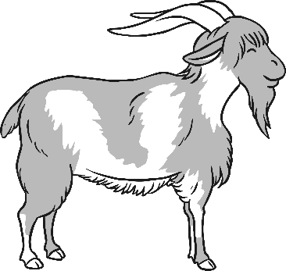
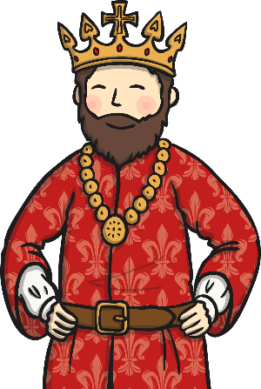
Click the pictures that contain the ‘oa’ sound to move them into the middle.
oa

Slide 9
Click the pictures that contain the long or short ‘oo’ sound to move them into the middle.
oo

Slide 10
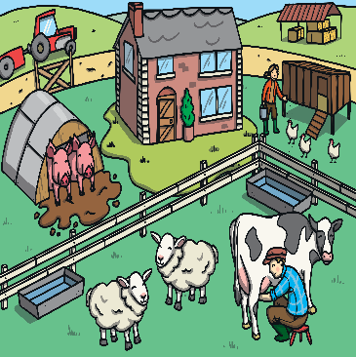
Click the pictures that contain the ‘ar’ sound to move them into the middle.
ar

Slide 11
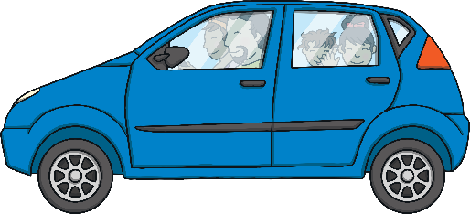
oa
igh
ee
ai
ar
or
oo

Slide 12
Getting Started
Both of these main/independent clauses make sense on their own.
Samira likes football.
Ben loves basketball.
and
When we link them together with a co-ordinating conjunction, they form a compound sentence.

Slide 13
Getting Started
There are seven co-ordinating conjunctions that we can remember using the mnemonic ‘FANBOYS’.
for
and
nor
but
or
yet
so
Samira likes football.
?
Ben loves basketball.
Which other co-ordinating conjunctions could be used to link these two main/independent clauses?

Slide 14
Next Steps
for
and
nor
but
or
yet
so
It was time for maths.
?
My pencil broke.
Which co-ordinating conjunctions could be used to link these two main/independent clauses to create a compound sentence?
Is there one that fits best?
Are some co-ordinating conjunctions easier to use than others?

Slide 15
Next Steps
for
and
nor
but
or
yet
so
Luke had lots of friends.
?
He was a friendly boy.
Which co-ordinating conjunctions could be used to link these two main/independent clauses to create a compound sentence?
Is there one that fits best?
Are some co-ordinating conjunctions easier to use than others?

Slide 16
Next Steps
for
and
nor
but
or
yet
so
?
You can choose strawberry ice cream.
You can choose vanilla ice cream.
Which co-ordinating conjunctions could be used to link these two main/independent clauses to create a compound sentence?
Is there one that fits best?
Are some co-ordinating conjunctions easier to use than others?

Slide 17
Success criteria
Lesson
Can identify ar words
Complete worksheet independently
Can identify ai words
Complete worksheet independently
Can identify and complete BOYS sentences
Complete worksheet independently, write a BOYS sentence of your own
Are you able you do these?

Slide 18
Now!
Download the worksheet of your colour group and complete.
You can complete on your computer OR print off OR write answers on a separate page

