Slide 1
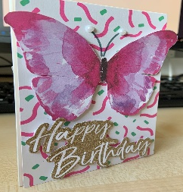
Manufacturing
Card Making

Slide 2
Learning Objectives
To correctly identify specific materials for each station using visual prompts.
To recall simple stages of a task to complete a set of instructions.
To recognise the difference between a good quality product and a poor quality product

Slide 3
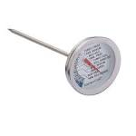
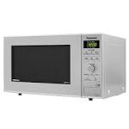
For card making I need…
Yes
No

Slide 4
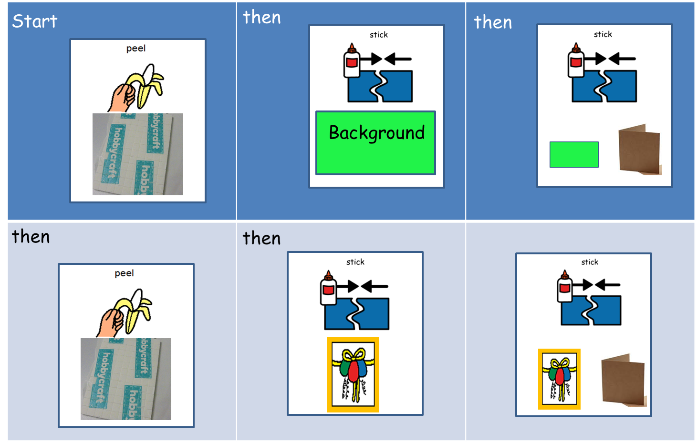
Card Making Steps
Start
then

Slide 5
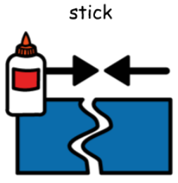
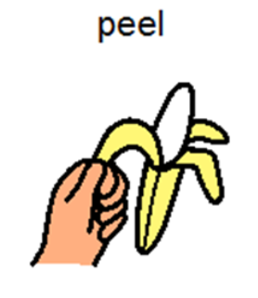
Print this page, cut out the symbols and try ordering them yourself at home.
then
Start
then
Background
Finish

Slide 6
Try ordering them yourself at home.
Print this page, cut out the symbols and stick on the step template.
then
Start
then
Start
then

Slide 7
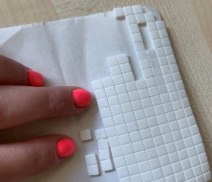
Follow the steps to make your own card.
You will need:
If you have card making equipment like sticky pads and blank cards at home, you can use them.
If you do not have that equipment you can use glue or sellotape and you can use a plain sheet of card or paper.
For the decoration you can recycle old cards or draw pictures to cut out and stick.
Look around your house and see what you can find. Be creative!
Ask an adult to help or supervise.
or
or
sticky pads
glue
Sellotape
Blank card or paper
scissors
Grease proof paper
Flowers for decoration
Heavy books
background
slogan

Slide 8
You can make this card with fresh flowers or dried. I used dried. Here is how I pressed them.
Cut the grease proof paper into squares.
Put a book on the table first, then paper on top.
Now lay your flowers onto the paper, be careful to lay them separately.
Put more paper on top and then a book.
Continue to do this until all of your flowers are squashed inbetween the paper and books.
Leave them for 1-3 weeks to dry well.

Slide 9
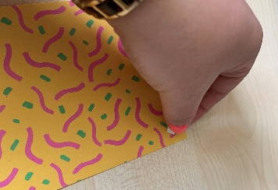
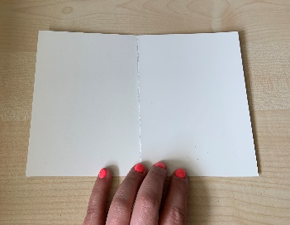
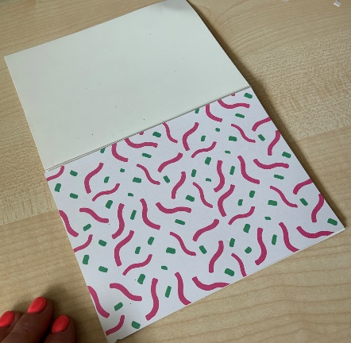
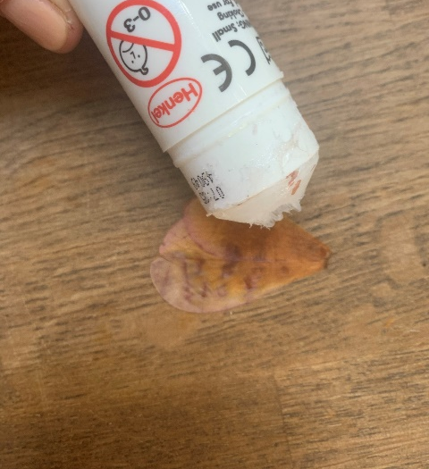
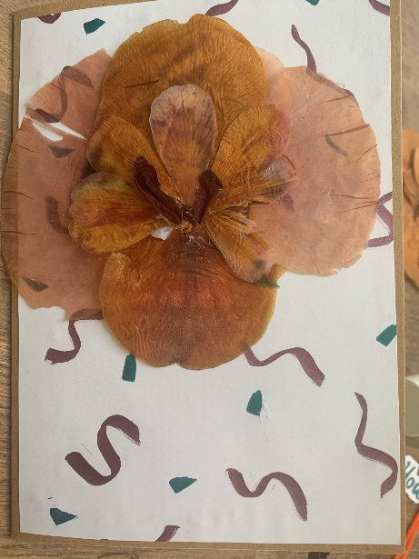
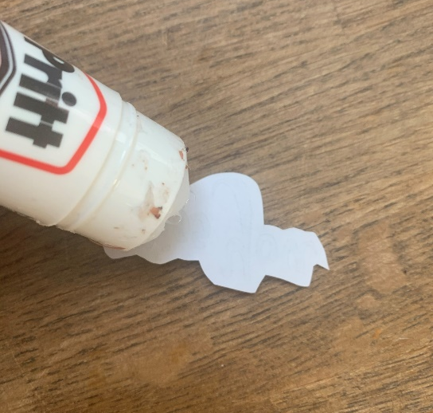
Follow the steps to make your own card.
If you are using sticky pads, remember to remove the paper on the back.
Take your plain card or paper and fold it in half, making sure that the corners match.
Stick the back ground piece to the front of the card. Make sure all of the edges are straight to match the front of the card.
Add sticky pads or glue to the back of the background piece.
Add sticky pads or glue to the back of the decoration piece.
Stick the decoration piece to the front of the card in the position you like.
Add sticky pads or glue to the back of slogan piece.

Slide 10
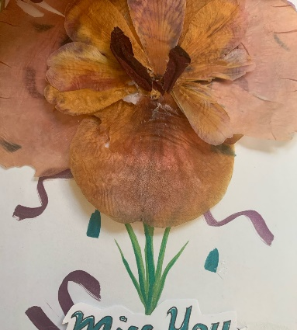
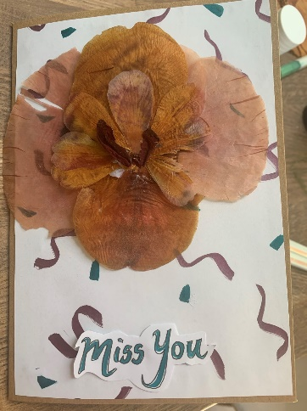
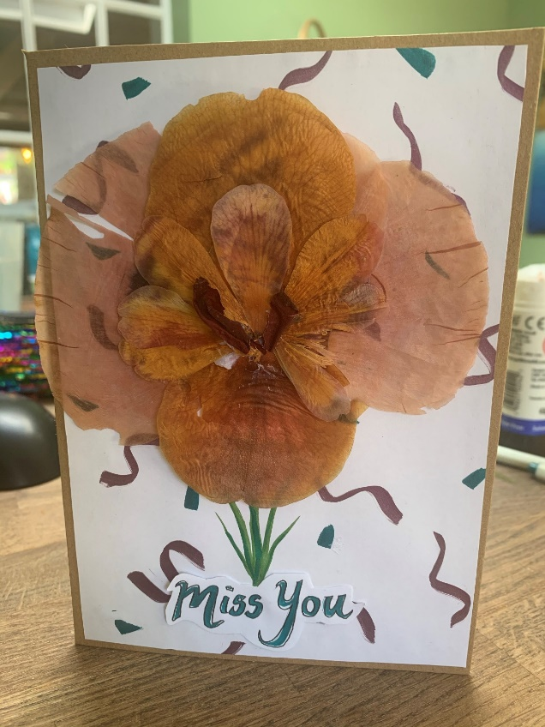
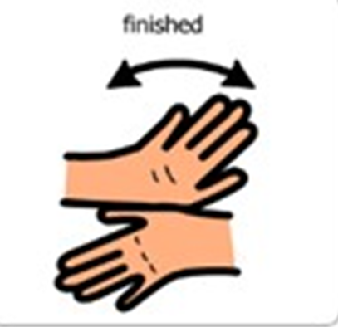
Follow the steps to make your own card.
Stick the slogan piece to the front of the card. Make sure it is underneath the decoration.
Add any extra decoration you would like. I’m adding stems to my flowers.

Slide 11
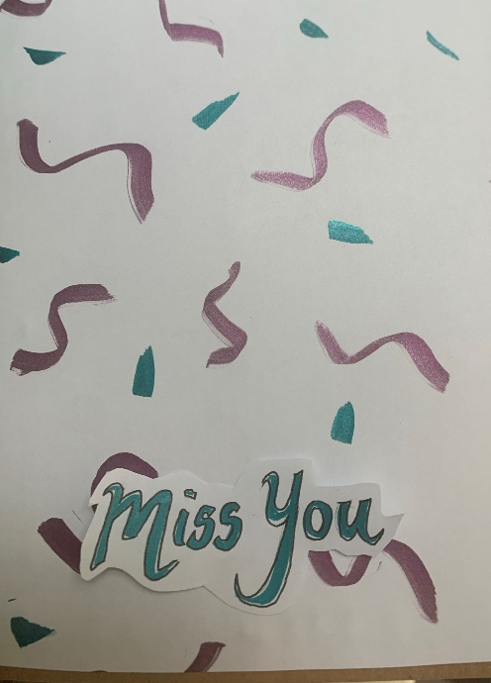
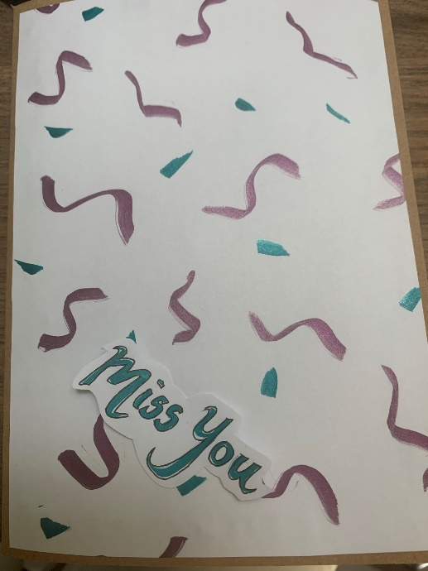
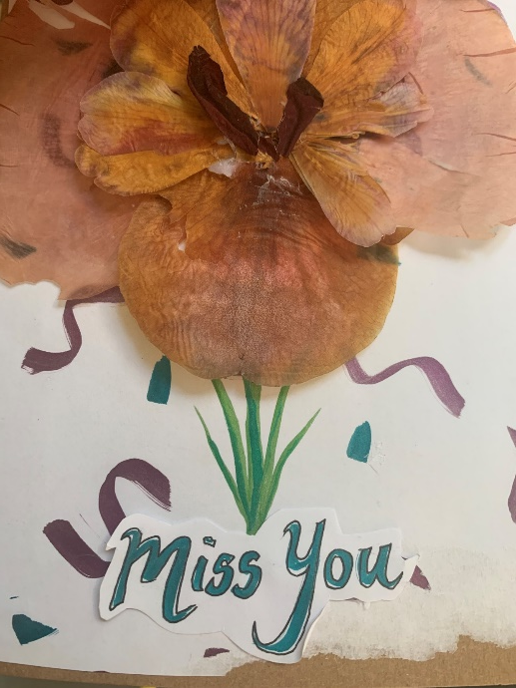
Good or Bad Quality
1
2
3
Which of these is good quality product and why?

